Slide 1
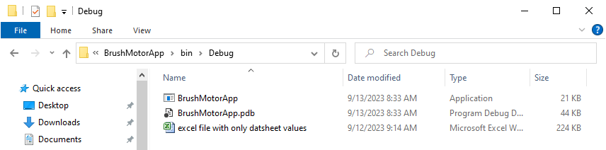
Located in the same directory of “BrushMotorApp” is the file “excel file with only datasheet values.”

Slide 2
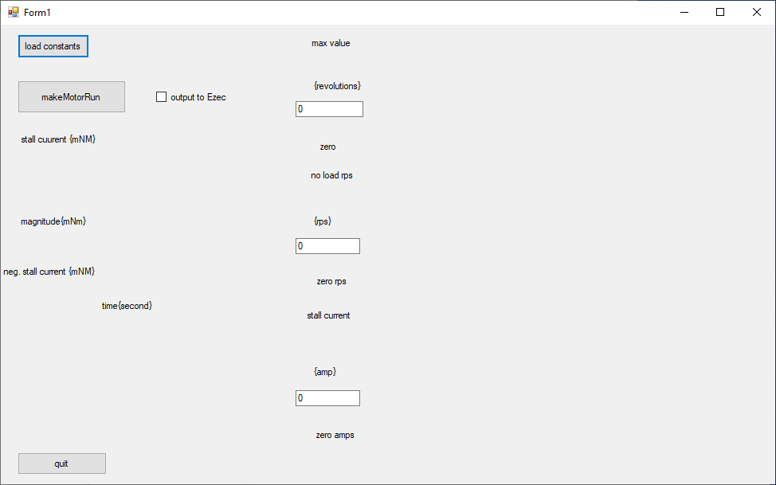
Double-clicking BrushMotorApp will execute the application to generate this screen:

Slide 3
Clicking “load constants” will load the datasheet from the collocated excel file.

Slide 4
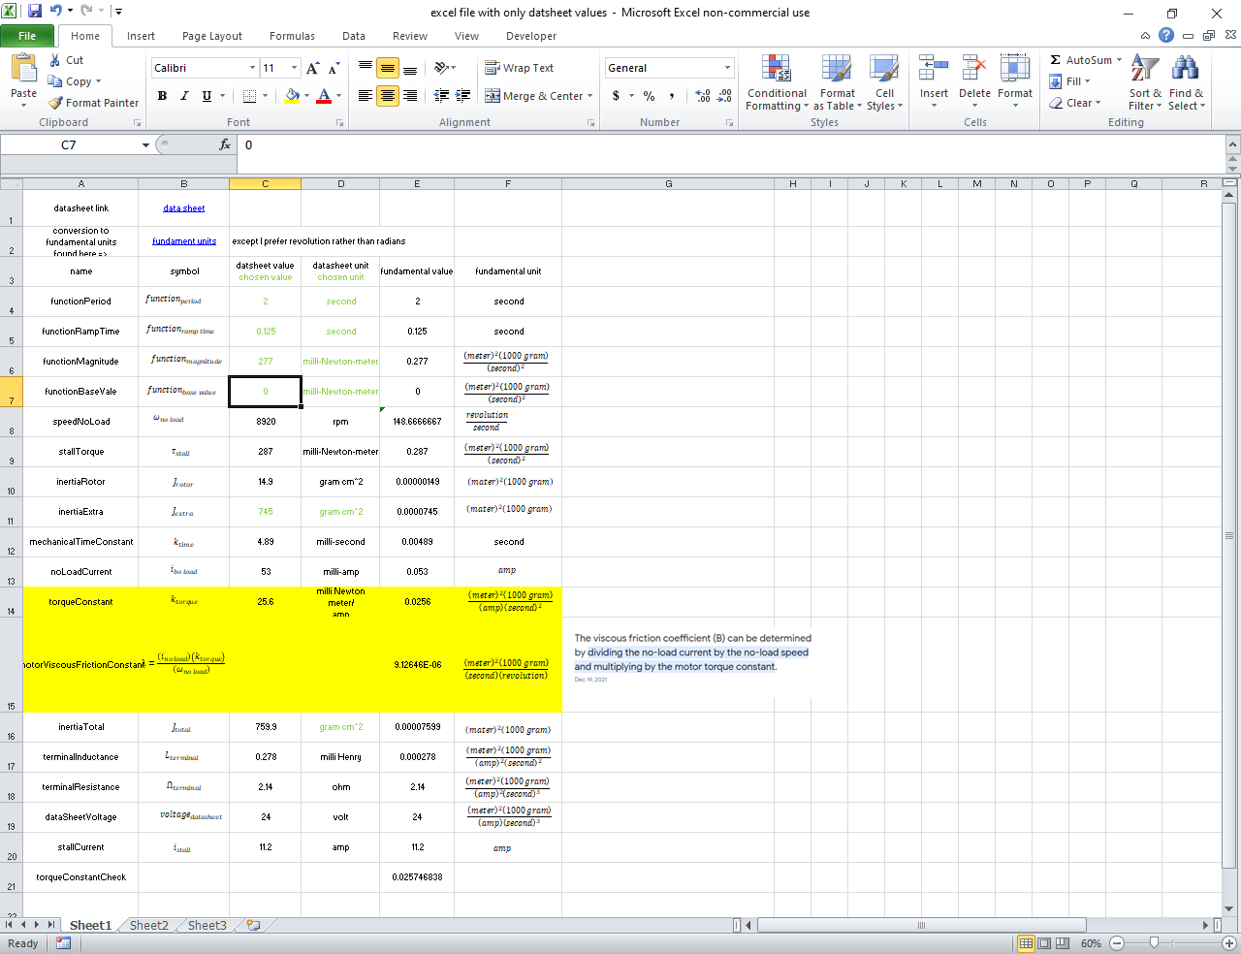
I transferred values from the Maxon data sheet to this spreadsheet. I think that the motor you are interested in will have a similar data sheet.
Note that I prefer numbers with fundamental units except for radians -- I prefer whole revolutions.

Slide 5
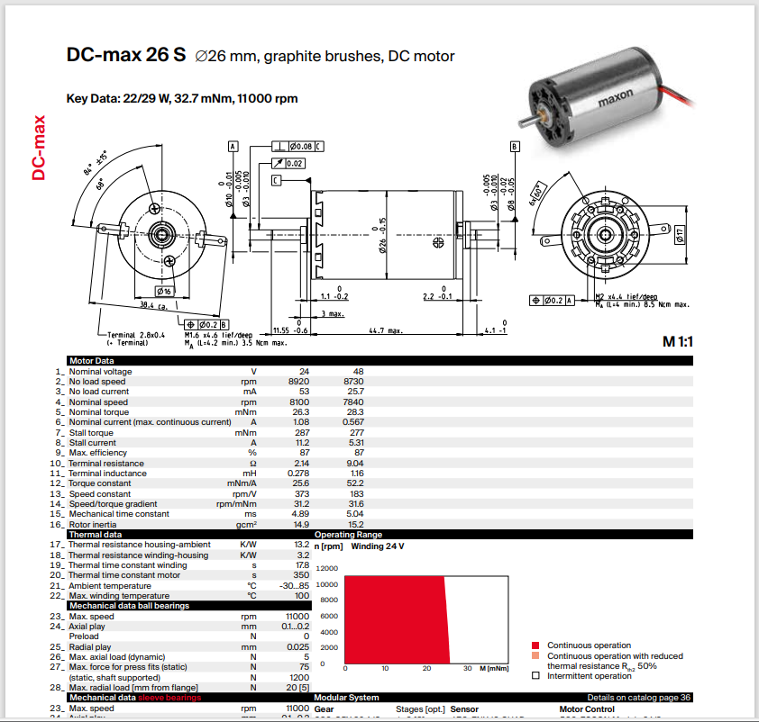
Clicking the datsheet link should bring up the Maxon 22 122 data sheet.

Slide 6
First, click the “load constants” button. This will load the constants used by the application and display a graph of the user defined load function applied to the motor as a function of time.

Slide 7
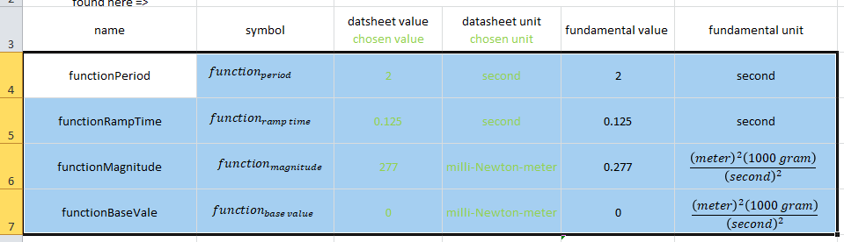
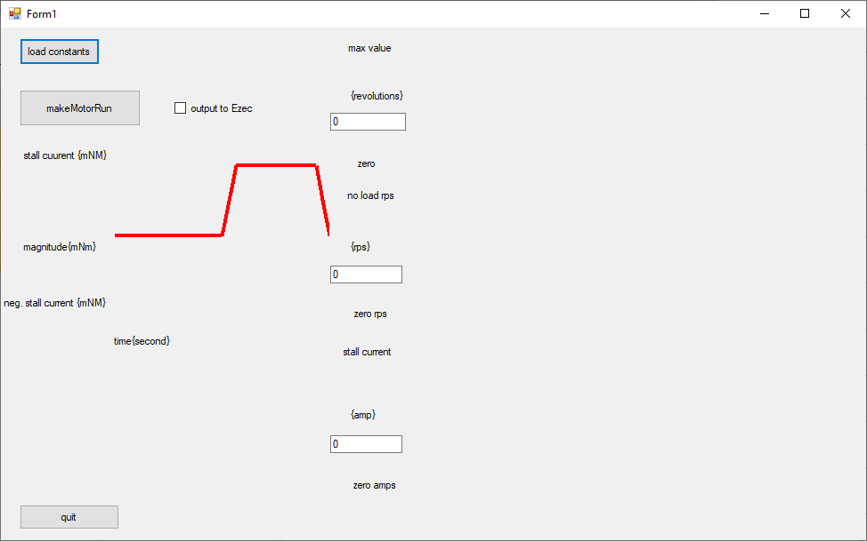
The function is defined in “excel file with only datasheet value”
Drawing of function

Slide 8
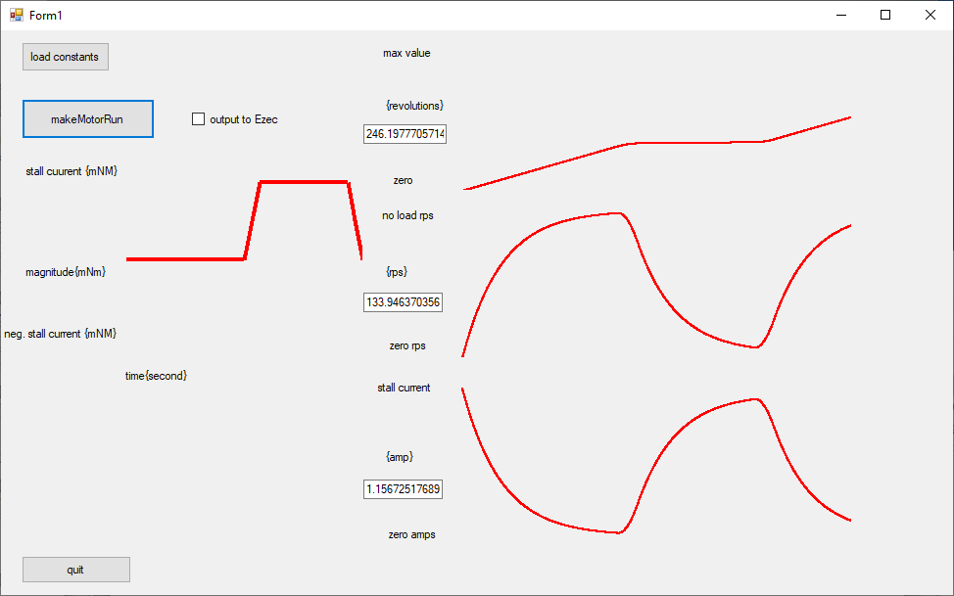
Next, click the “makeMotor run” button. This will document the position, speed, and electrical current consumption of the motor over 2.5 seconds.
Check “ouput to excel” and the data shown graphically will be shown in an excel worksheet.

Slide 9
Future Work
Correct spelling of “excel”
Better document of initial conditions
Variable time constant
Add alternative to “makeMotorRun” that calculates position speed and current through numerically solving three simultaneous differential equations
Better position all graph axis labels.
Add ability to control the “step size” .0004 is too large; .0003 works
Document exponential functions used
Eliminate linked list of datapoints?
Test cases
No load
Constant load
Load that turns on after a second and off at second two

Slide 10
